Slide 1
Team 7
Security
Authentication Authorization

Slide 2



Team members
Harshitha Chetty Ragava
Zaiba Ali
Vamshi Krishna Nuka

Slide 3
Security
Security is an integral part on any web app.
Security ia all about protecting your assets from unauthorised actions.
The main purpose of security is to prohibit unauthorized users from accessing sensitive information or performing certain tasks and actions.
ASP.NET Core and EF contain features that help you secure your apps and prevent security breaches.
Zaiba Ali

Slide 4
Common vulnerabilities in software
Cross-site scripting attacks
SQL injection attacks
Cross-Site Request Forgery (CSRF)
Open redirect attacks
Zaiba Ali

Slide 5
Some of the year’s biggest data breaches
Facebook : This is the notorious Cambridge Analytica scandal where the data-collecting firm illegally harvested users’ info without their permission. The secret operation was politically motivated.
Quora: The question-and-answer site reported to its users that a third party had gained unauthorized access to one of their systems.
Starwood: It”s server had suffered unauthorised access.
Panera: Despite being warned by a cybersecurity expert in August 2017 that their website was leaking data
Zaiba Ali

Slide 6
What is authentication?
Vamshi Krishna Nuka

Slide 7
Authentication
Authentication is a process of determining who you are.
Something like:
Password
Smart card
FingerPrint or other biometric method
Vamshi Krishna Nuka

Slide 8
Authentication Components
Identity
Verbs
Authentication Handlers
Middleware
Vamshi Krishna Nuka

Slide 9
Identity
Three classes that represent the identity of a user:
Claims
Claims Identity
Claims Principal
Vamshi Krishna Nuka

Slide 10
Authentication in ASP.NET Core
Understanding the system first requires understanding its components and behaviors.
They can be broken into
- Identity
- Verbs
- Authentication handlers
- Middleware
Vamshi Krishna Nuka

Slide 11
Identity:Claims
A Claim represents a single fact about the user.
It could be the user's first name, last name, age, employer, birth date, or anything else that is true about the user.
A single claim will contain only a single piece of information.
Vamshi Krishna Nuka

Slide 12
Identity:Claims (continued..)
Claims are represented by the Claim class in ASP.Net Core. It's most common constructor accepts two strings: type and value.
The 'type' parameter is the name of the claim, while the value is the information the claim is representing about the user.
Example: new Claim("Name","Vamshi");
Vamshi Krishna Nuka

Slide 13
Identity:ClaimsIdentity
An Identity represents a form of identification or, in other words, a single way of proving who you are.
In ASP.Net Core, it is a ClaimsIdentity.
A single instance of a ClaimsIdentity can be authenticated or not authenticated.
Vamshi Krishna Nuka

Slide 14
Identity:ClaimsPrincipal
A Principal represents the actual user. It can contain one or more instances of ClaimsIdentity.
ClaimsPrincipal represents a user and contains one or more instances of ClaimsIdentity.
HttpContext.SignInAsync method accepts and passes to the specified AuthenticationHandler.
Vamshi Krishna Nuka

Slide 15
Verbs
There are 5 verbs that are invoked by the auth system, and are not necessarily called in order.
These are all independent actions that do not communicate among themselves, however, when used together allow users to sign in and access pages otherwise denied.
Vamshi Krishna Nuka

Slide 16
Verbs (Continued..)
Authenticate
Gets the user’s information if any exists (e.g. decoding the user’s cookie, if one exists)
Challenge
Requests authentication by the user (e.g. showing a login page)
SignIn
Persists the user’s information somewhere (e.g. writes a cookies)
Vamshi Krishna Nuka

Slide 17
Verbs (Continued..)
SignOut
Removes the user’s persisted information (e.g. deletes the cookies)
Forbid
Denies access to a resource for unauthenticated users or authenticated but unauthorized users (e.g. displaying a “not authorized” page)
Vamshi Krishna Nuka

Slide 18
Authentication Handlers
Authentication handlers are components that actually implement the behavior of the 5 verbs above.
The default auth handler provided by ASP.NET Core is the Cookies authentication handler which implements all 5 of the verbs.
It is important to note, however, that an auth handler is not required to implement all of the verbs.
Harshitha Chetty Ragava

Slide 19
Authentication Middleware
A middleware is a module that can be inserted into the startup sequence and is run on every request.
When the request is run, the authentication middleware asks the default scheme auth handler to run its authentication code.
The auth handler returns the information to the authentication middleware which then populates the HttpContext.
Harshitha Chetty Ragava

Slide 20
Authorization
Authorisation revolves around what you are allowed to do, i.e. permissions.
Before you can determine what a user is allowed to do, you need to know who they are,so when authorisation is required, you must also first authenticate the user in some way.
The authorization step prevents people from seeing data of other students.
Harshitha Chetty Ragava

Slide 21
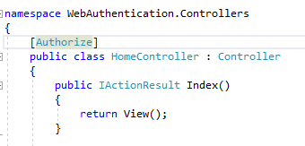
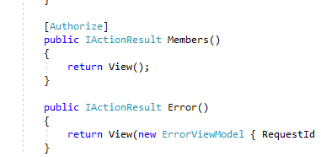
Let’s talk about code
[Authorize]
Restrict access to an action method and make sure that only authenticated users can execute it.
Harshitha Chetty Ragava

Slide 22
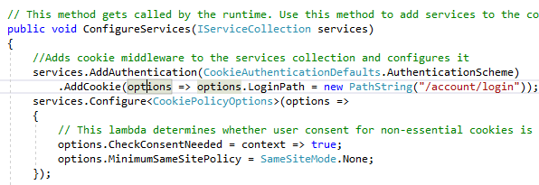
Code (Continued..)
AddAuthentication:
Harshitha Chetty Ragava

Slide 23

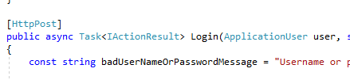
Code (Continued..)
Harshitha Chetty Ragava

Slide 24
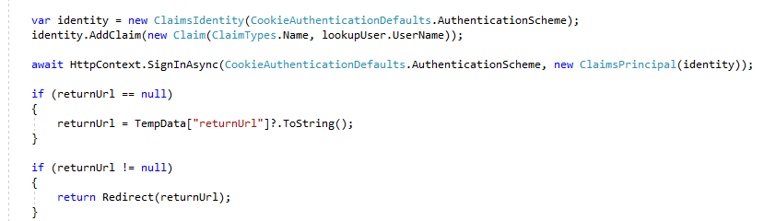
Code(Continued..)
Harshitha Chetty Ragava

Slide 25
References:
https://digitalmccullough.com/posts/aspnetcore-auth-system-demystified.html
https://andrewlock.net/introduction-to-authentication-with-asp-net-core/
https://docs.microsoft.com/en-us/aspnet/core/security/?view=aspnetcore-2.2
https://blog.avast.com/biggest-data-breaches

Slide 26


